Slide 1

5. Applications of UV-Vis spectroscopy
1) Structural information
Spectra Band Position, Shape and Intensity
Position: Conjugation length
Shape: Molecular type
Intensity: Transition types (K band, B band and etc.)
Notes:
中: 3.5 + 3.2.1 各种带 + 3.3 各类化合物的紫外谱及经验算法
英: 1.9 如何选择Chrome + 1.11-1.21 各类化合物紫外谱经验算法

Slide 2
Type | Transition | Wavelength (Position) | Intensity | Fine structure | More
Alkanes | σ−σ∗ | <210 nm | N/A | No
Single alkenes | π−π∗ | <210 nm | N/A | No
Single ketones | π−π∗ n−π∗ | <210 nm 270-350 nm (possibly) | N/A R Band (Weak ε~10) | No
Conjugated alkenes | π−π∗ | 220-250 nm | K Band (Strong ε_{max}~10⁴) | No | > 300 nm: longer conjugation
Conjugated ketons | π−π∗ n−π∗ | 220-250 nm 270-350 nm | K Band (Strong ε_{max}~10⁴) R Band (Weak ε~100) | No
Aromatics | π−π∗ (n−π∗) | 220-250 nm 250-300 nm 270-350 nm (always covered) | K Band (Strong ε_{max}~10⁴) E Band (Medium ε_{max}~10³) R Band | Yes | λ_{max} ~visible region More bands and fine structures: Polycyclic aromatics
Notes:
中: 3.5 + 3.2.1 各种带
英: 1.9 如何选择Chrome

Slide 3
2) Structure determination with λ_{max}
Calculate the λ_{max} of the organic compounds with empirical rules (eg. Woodward rule) and compare with the experimental date to determine the real structures of the organic compound.
Notes:
中: 3.5 + 3.3 各类化合物的紫外谱及经验算法
英: 1.9 如何选择Chrome + 1.11-1.21 各类化合物紫外谱经验算法

Slide 4
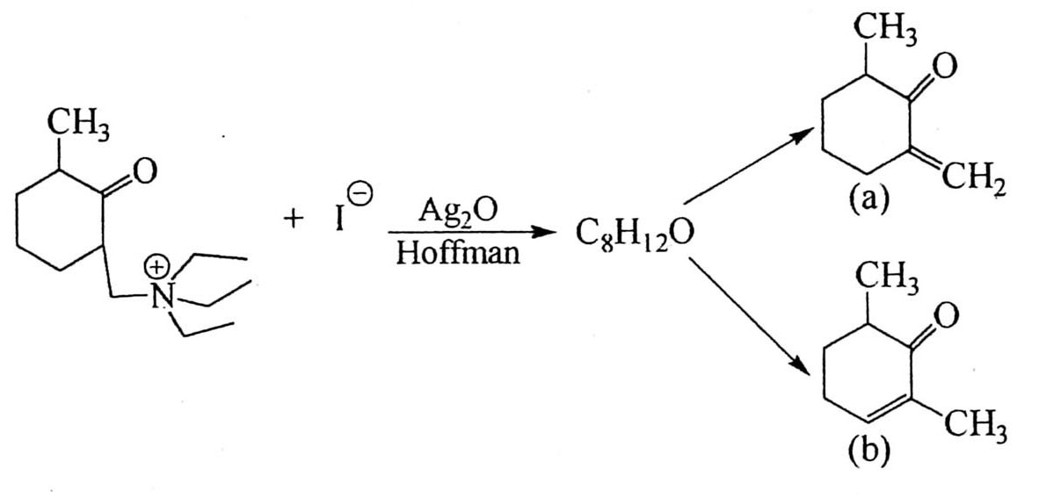
Reaction pathway and product
Eg.1 The UV-vis spectra shows that the λ_{max} of the ethene product from Hoffman elimination reaction is at 236 nm. What is the possible product (a or b)?

Slide 5
According to the Woodward rule:
λ_{max}= a, b-unsaturated aliphatic ketone + 1×α-R + exocyclic double bond=215+10+5=230 nm
(b) λ_{max}= a, b-unsaturated aliphatic ketone + 1×α-R + 1×β-R =215+12+10=237 nm

Slide 6
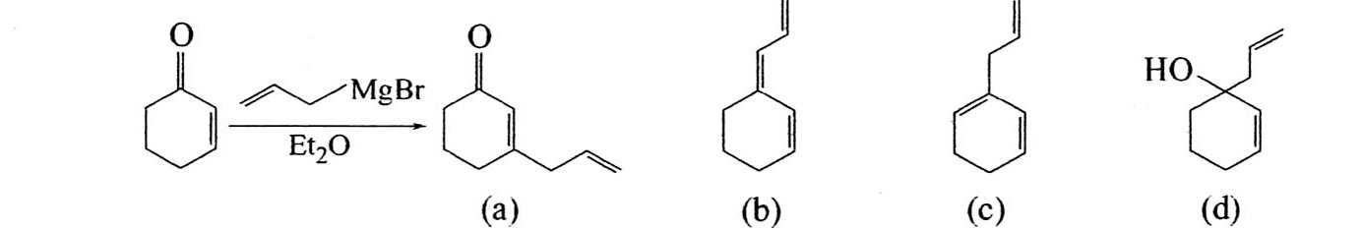
Eg.2 The major product separated after the Grignard reaction exhibits a λ_{max} at 254 nm. The structure of the product would be a/b/c/d?

Slide 7
(a) α, β-unsaturated ketone: λ_{max}=215+2×12=239 nm
(b) Conjugated alkene: λ_{max}=217+2×5+5+30=262 nm
(c) Conjugated cycloalkene: λ_{max}=253+3×5=268 nm
(d) Non-conjugated structure

Slide 8
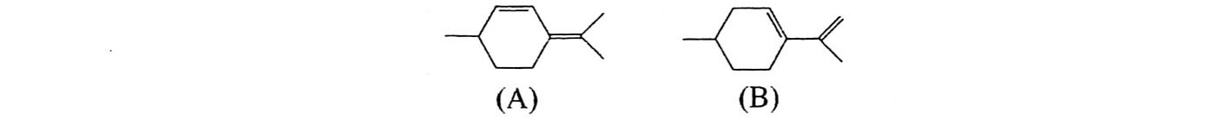
Natural product analysis
Eg.3 Please determine the structure of a major component extracted from an oil. λ_{max}=242 nm in hexane.

Slide 9
(A) λ_{max}=Conjugated alkene+4 alkyl substitutions+1 exocyclic double bond=217+4×5+5=242 nm
(B) λ_{max}= Conjugated alkene +3 alkyl substitutions =217+3×5=232 nm

Slide 10
Eg.4 Please calculate the λ_{max} of α/β-lonone
α-Ionone β-Ionone
Lonone is a well-know perfume which possesses two isomers, α-lonone and β-lonone. α-lonone has a more favorable smell which is often used for cosmetics, while β-lonone is just for soap producing.
Notes:
α-Ionone λ_{max} = 228 nm β-Ionone λ_{max} = 298 nm

Slide 11
Eg.5 Please determine the structure of cyperone
The measured value of cyperone is 251 nm.
Notes:
(a)λmax 227nm (b)λmax 254nm

Slide 12
Photoisomers
a. Cyclization isomerization
eg. Diarylethene
b. Trans-Cis isomerization
eg. Azobenzene

Slide 13
6. UV-Vis spectrometers
Monochromator-spectrometers
Dichromator-spectrometers
Notes:
中: 3.1

